Slide 1
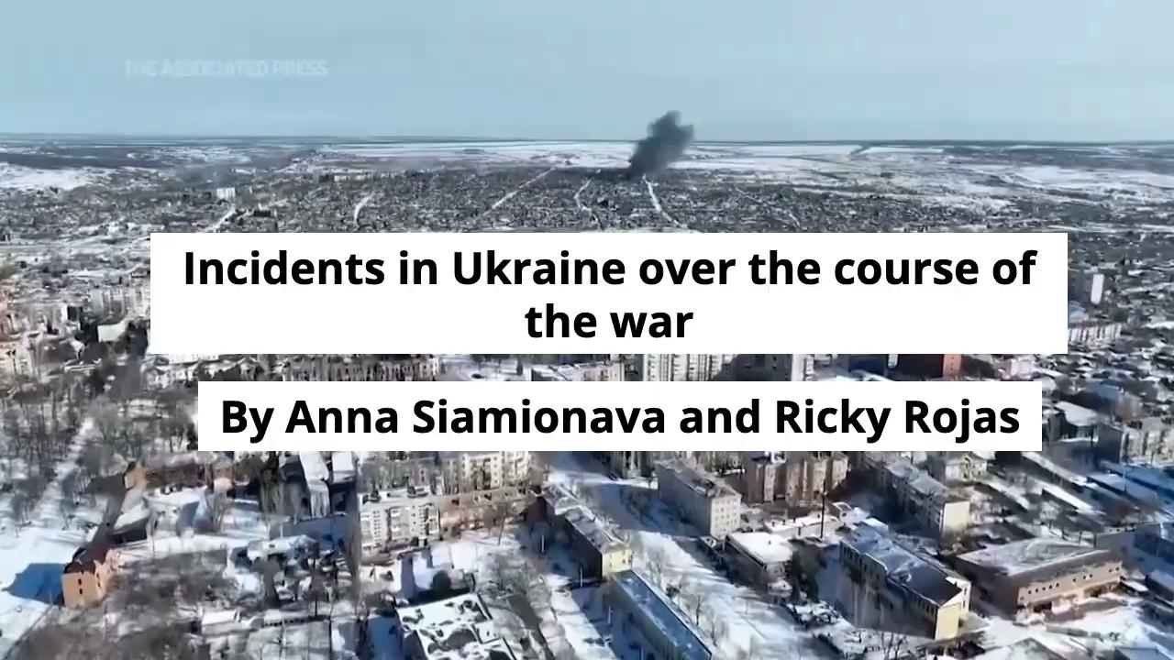
Incidents in Ukraine over the course of the war
By Anna Siamionava and Ricky Rojas

Slide 2
65.000
Suspected war crimes
8.1M
Refugees from Ukraine recorded across Europe as of February 15
5.3M
Ukrainians are displaced within the country
21,293
Estimated civilian casualties in Ukraine 100.000+
Estimated troops casualties in Ukraine
€54.9B
Financial, humanitarian and military aid pledged by EU countries and institutions
389
Days of war

Slide 3
Research Question + Data

Slide 4
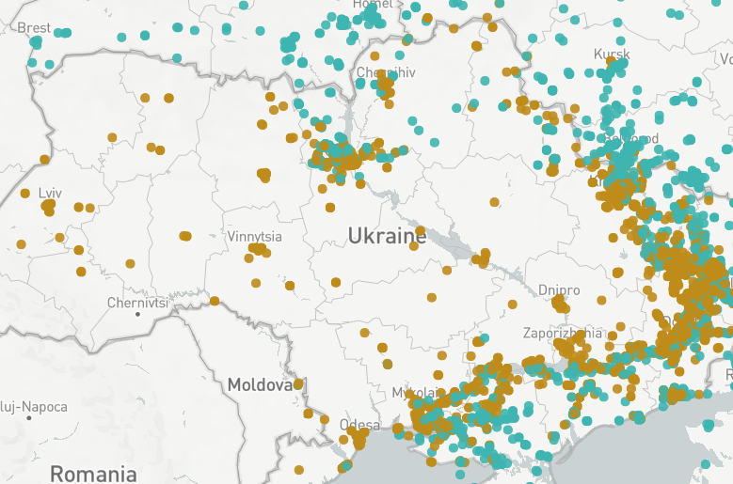
War Characterization
Lots of maps like these (eyesonrussia.com)
Problem:
Created with limited data
This visualization is created with just 1000 data points
Limited visualizations

Slide 5
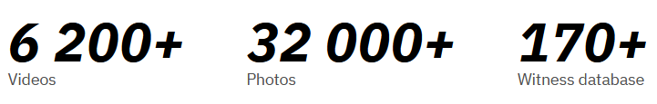
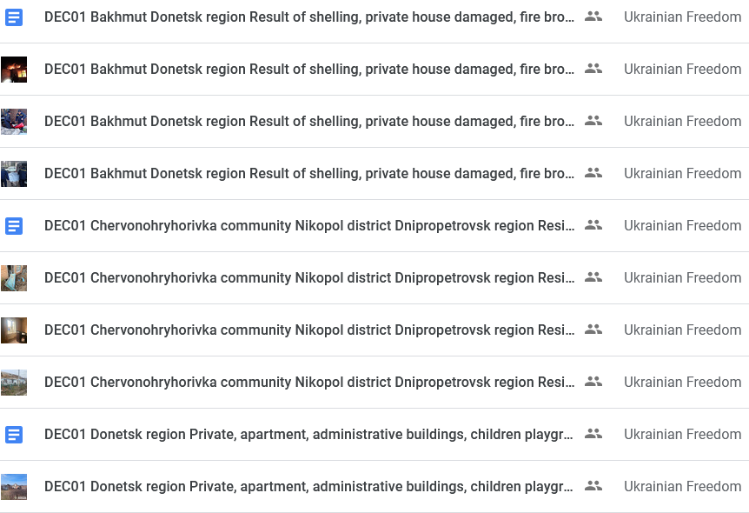
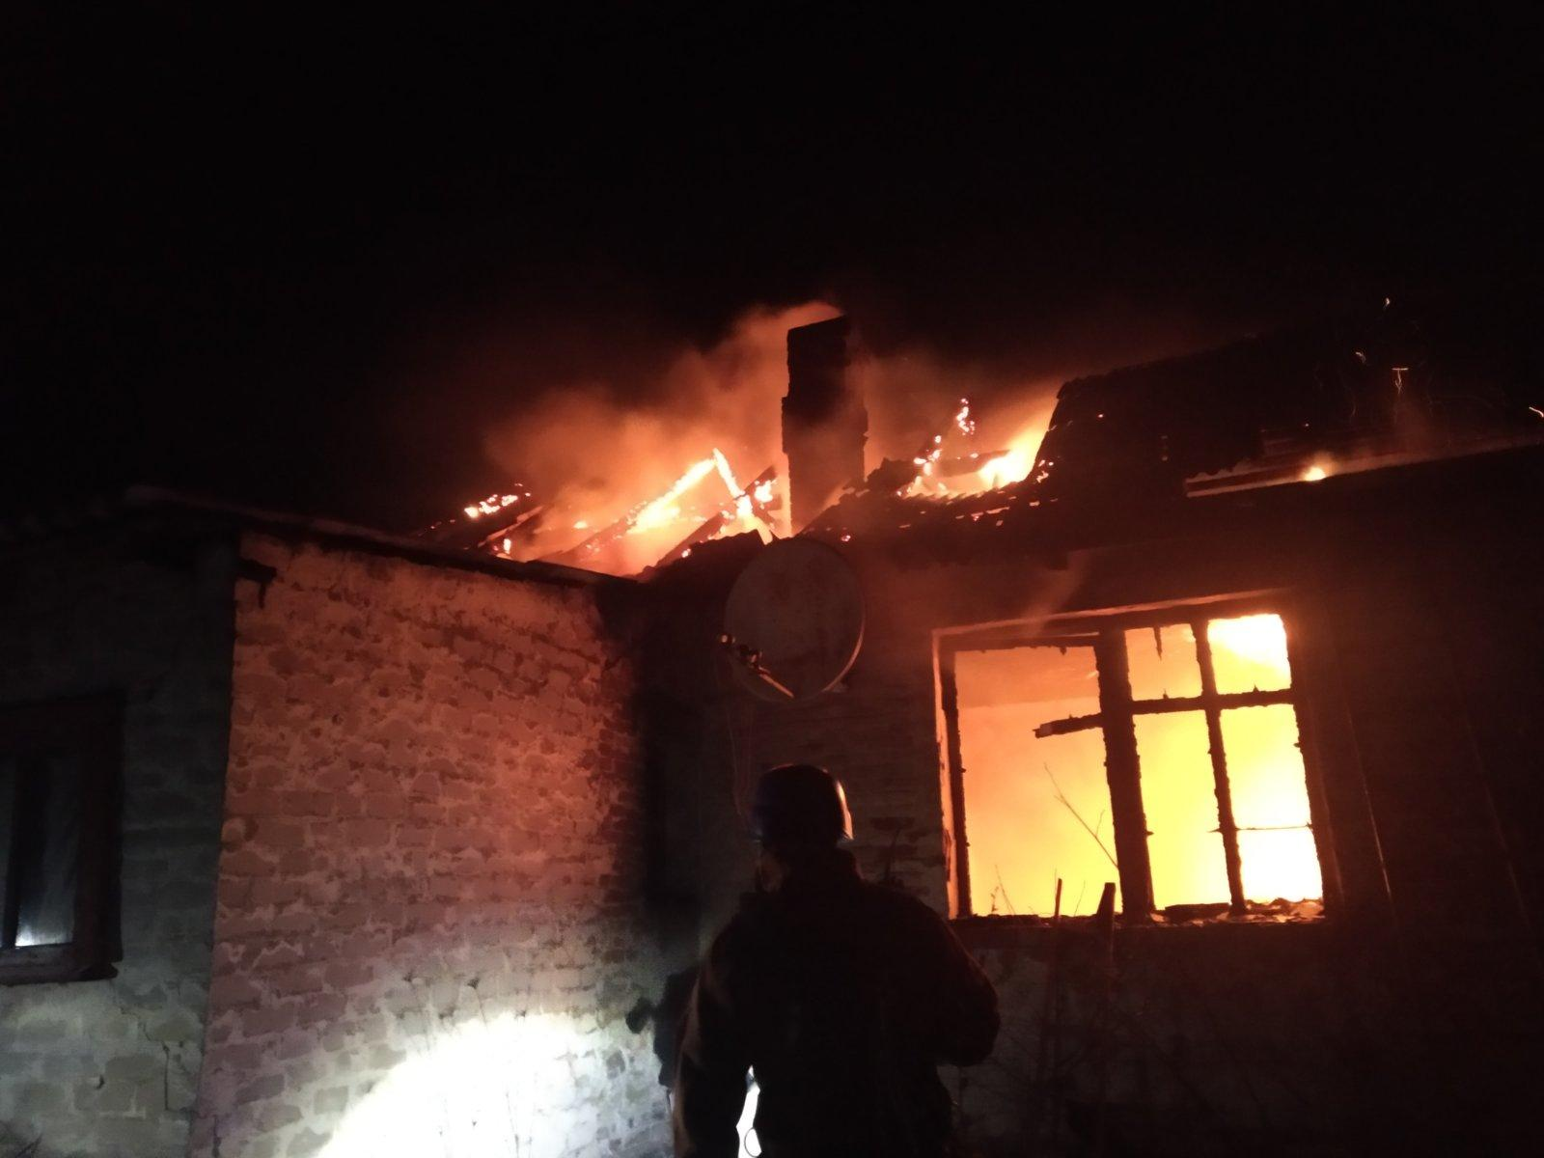
Dattalion
DEC01 Bakhmut Donetsk region Result of shelling, private house damaged, fire broke out. 2 people injured 1.jpg

Slide 6
Can we use Dattalion to create better visualizations that more accurately characterize the war in Ukraine?

Slide 7
Cleaning

Slide 8
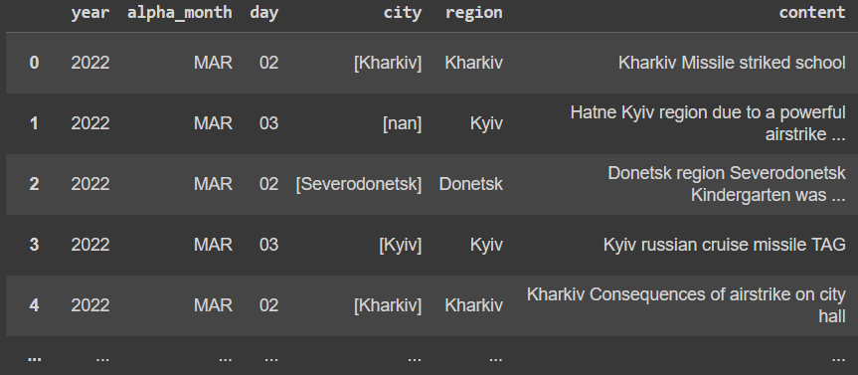
Scraping
DEC01 Bakhmut Donetsk region Result of shelling, private house damaged, fire broke out. 2 people injured 1.jpg

Slide 9
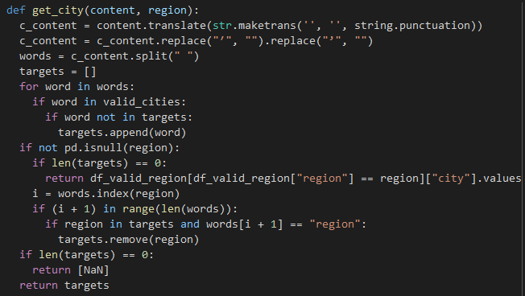
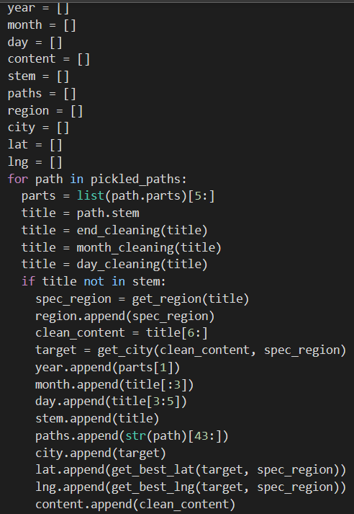


Slide 10
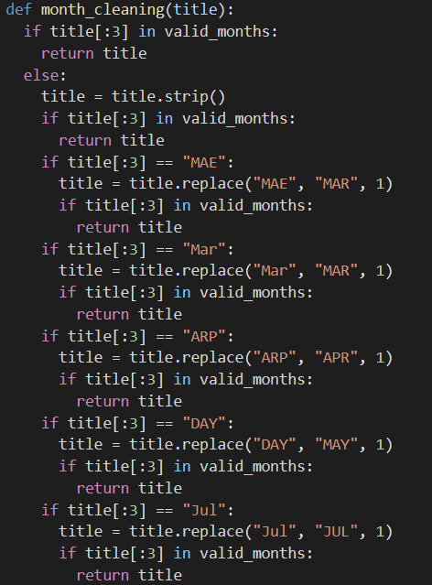

Problems w/ Cleaning: Typos and Data

Slide 11
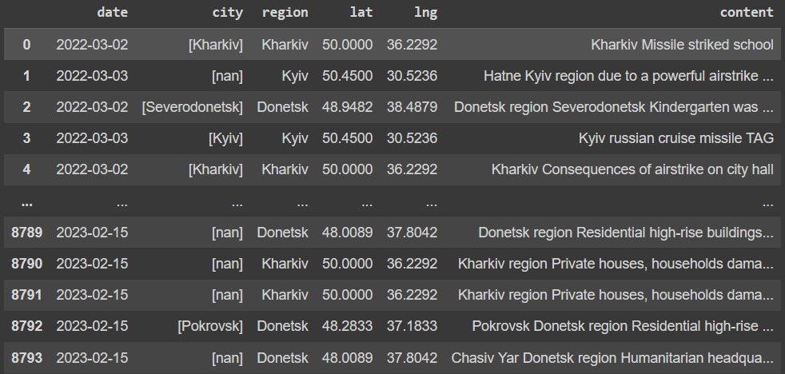
Final Cleaning: Date and Coordinates

Slide 12
Visualizations

Slide 13

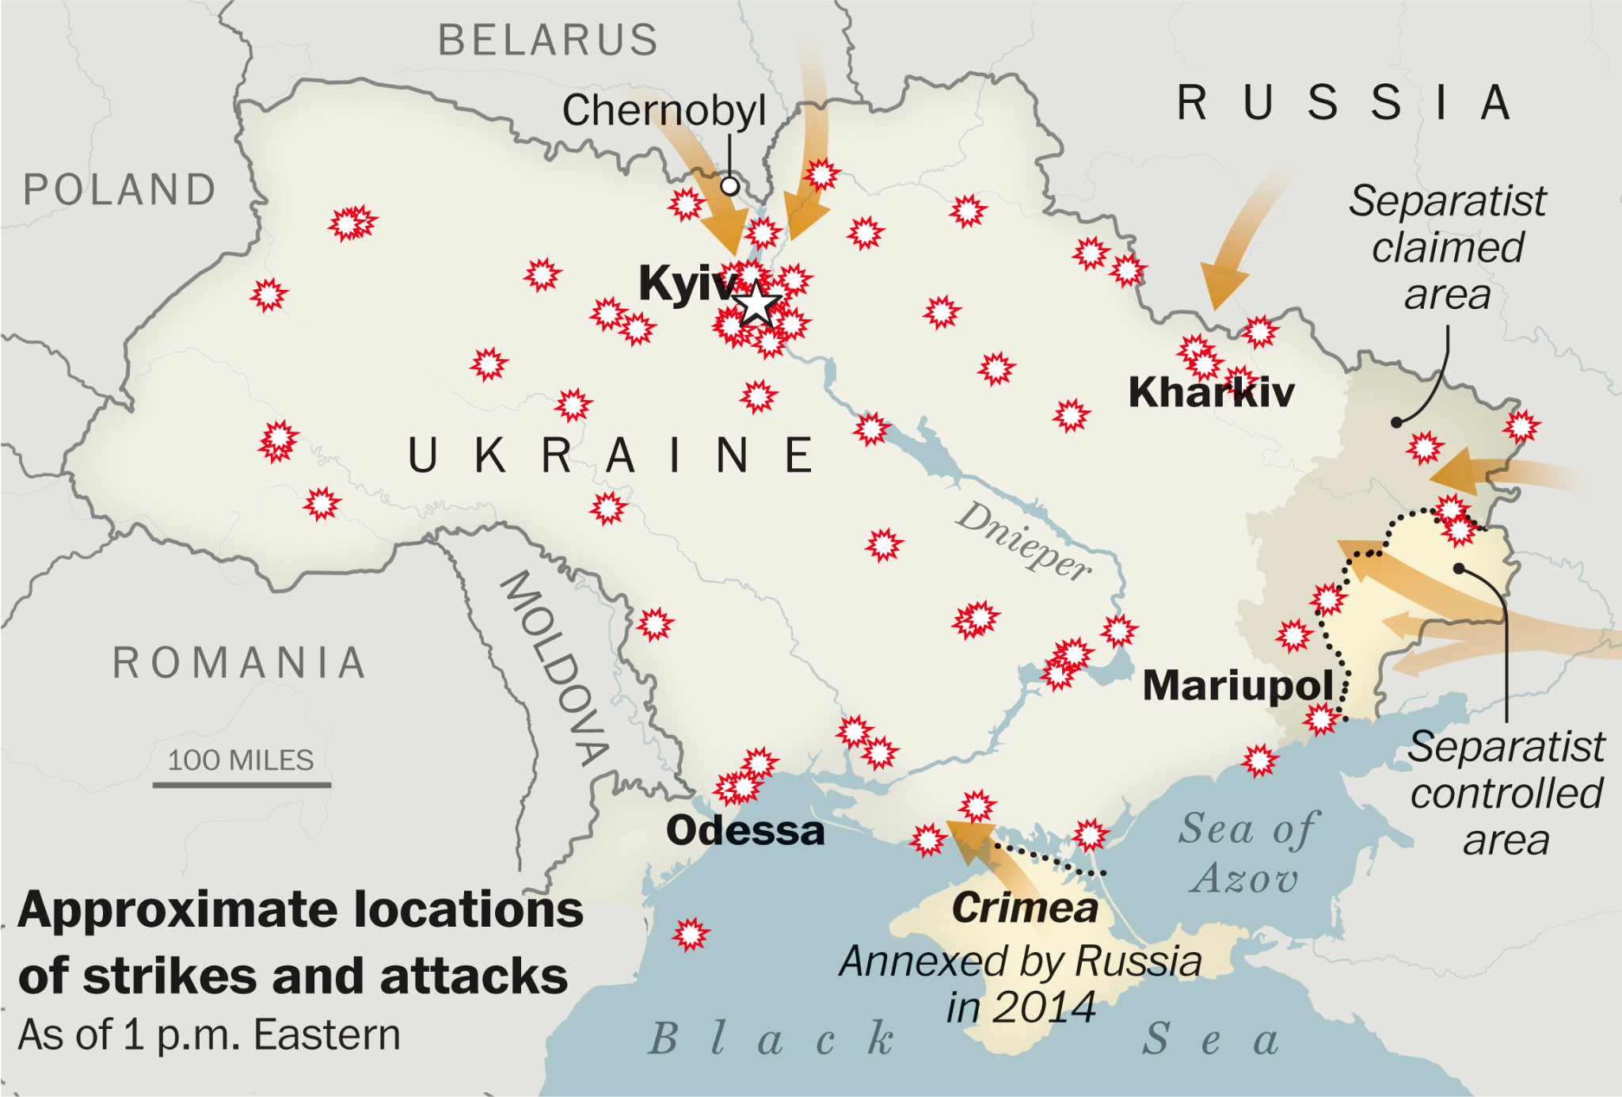
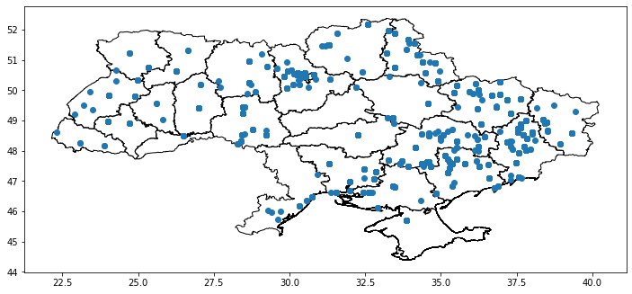
Accuracy of the Internet map vs ours

Slide 14
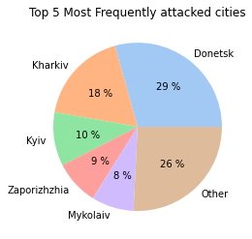
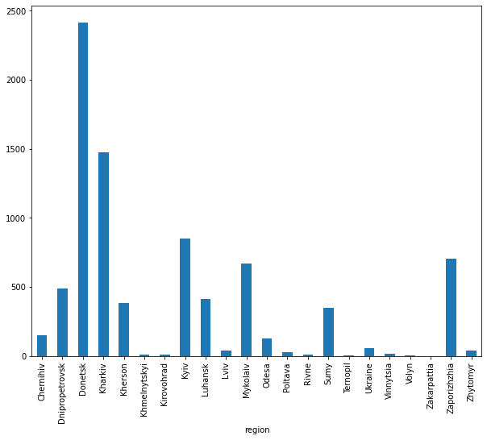
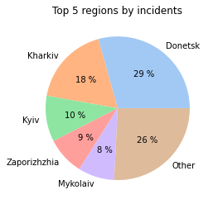
Frequency of incidents based on regions
Frequency of attacks based on regions

Slide 15
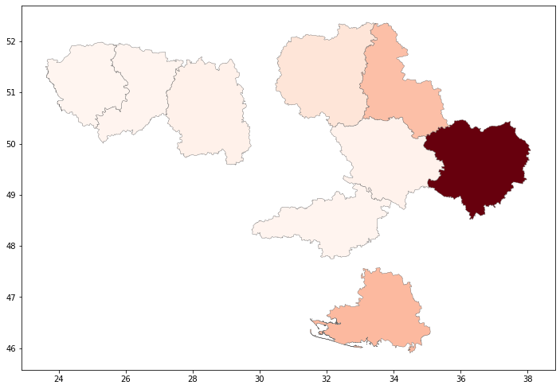
Heatmap

Slide 16
Heatmap
Wait, why it doesn’t show every region?

Slide 17
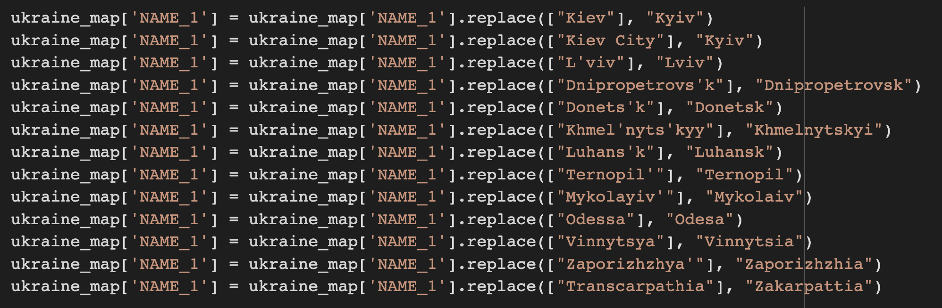
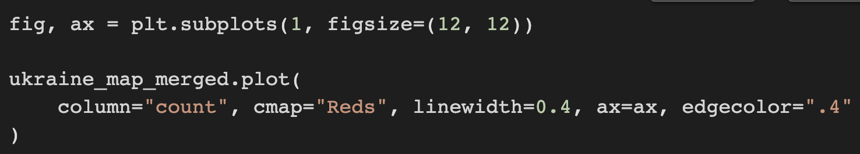

Slide 18
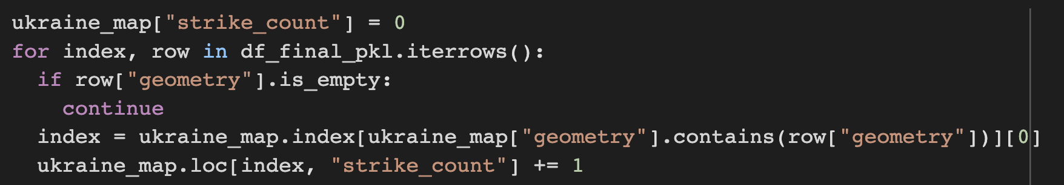
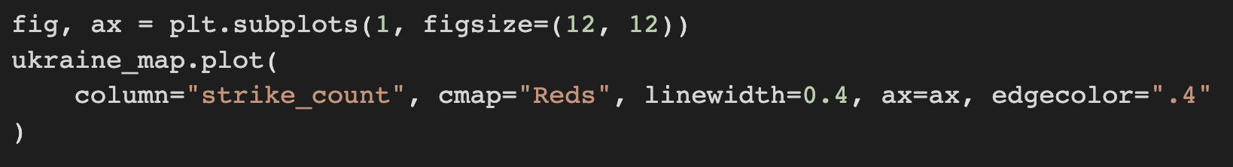

Slide 19
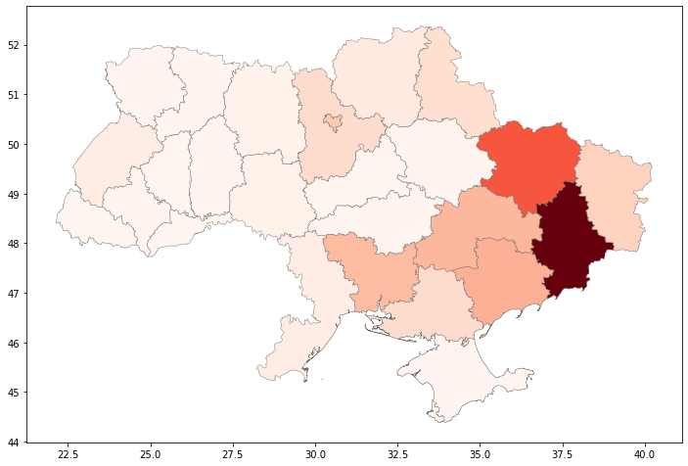

Slide 20
Machine Learning

Slide 21
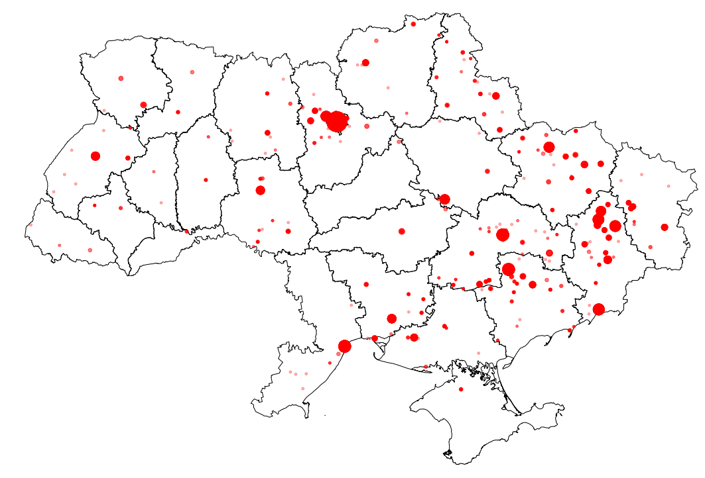
Clustering

Slide 22
Clustering Goals
To predict incidents with similar characteristics
To show continuity through space and time

Slide 23
Evaluating Clusters

Slide 24
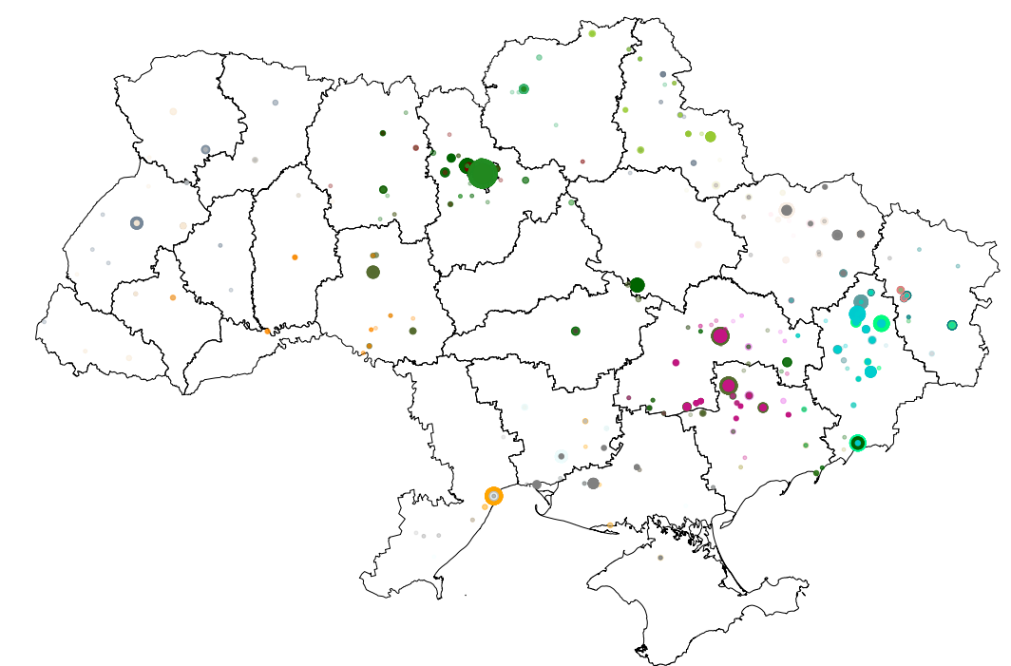
Clustering: K-Means

Slide 25
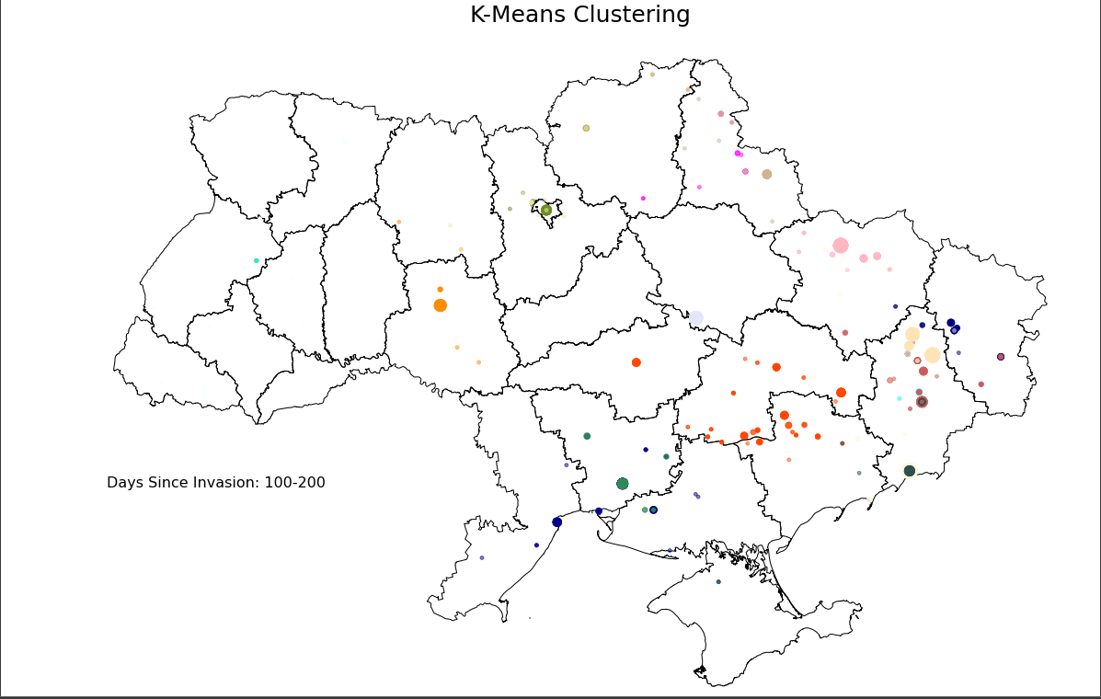

Slide 26
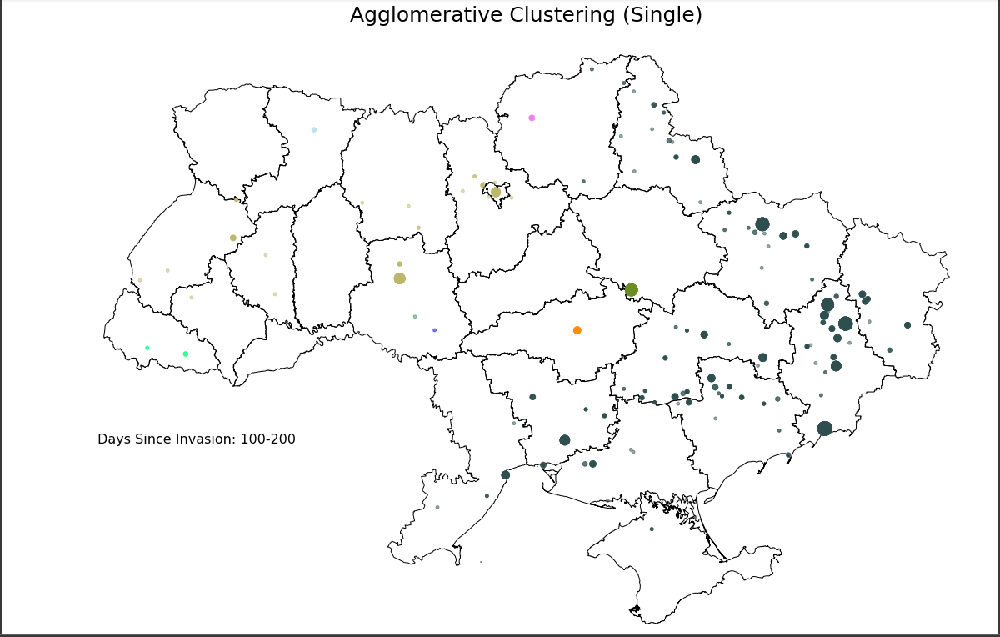

Slide 27
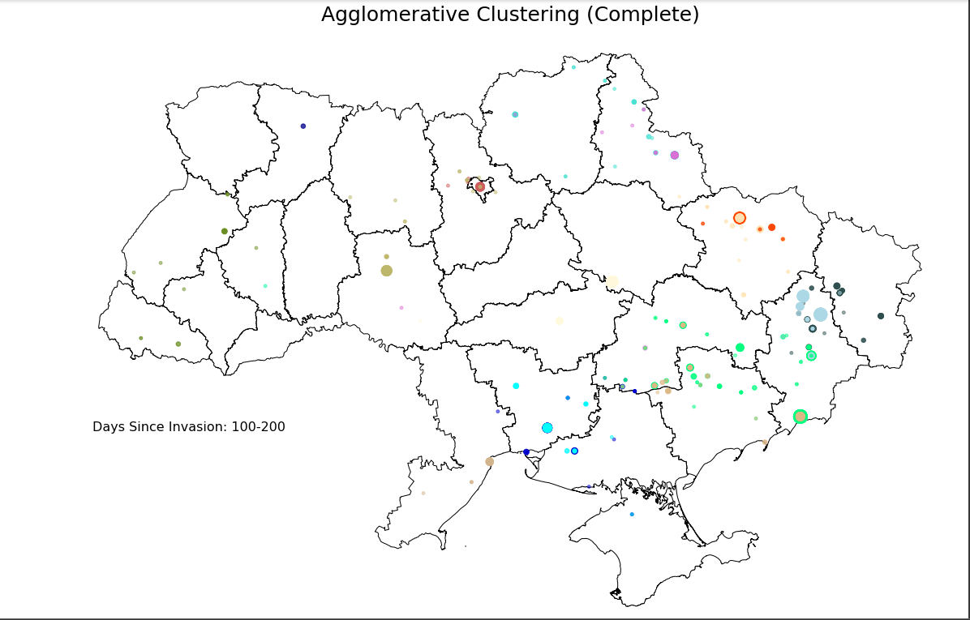

Slide 28
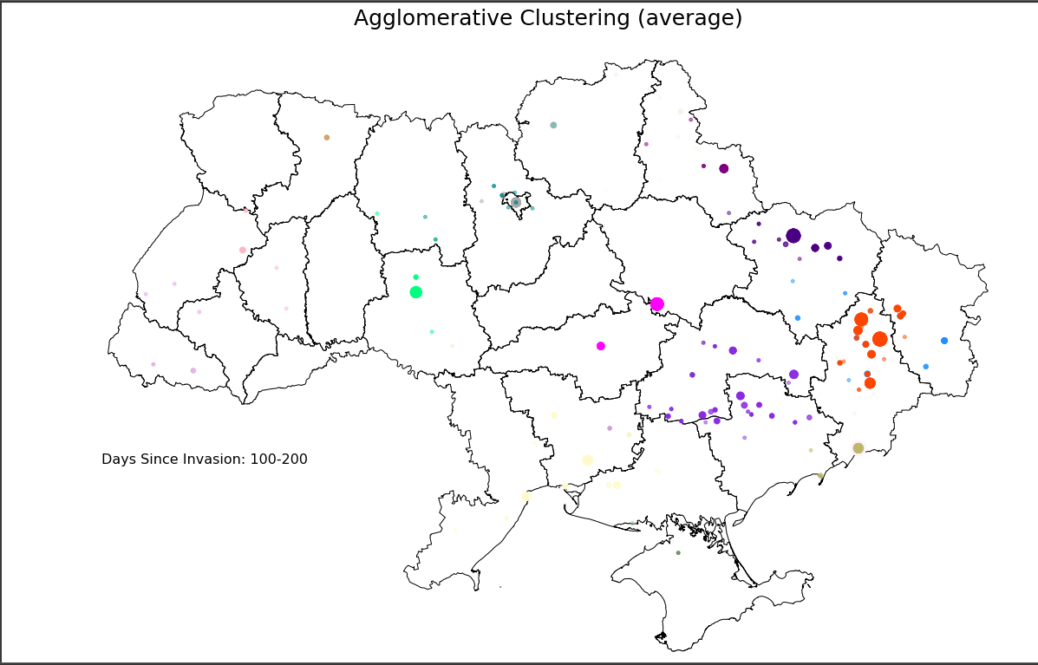

Slide 33
K-Means Clustering vs AgC Average?

Slide 34
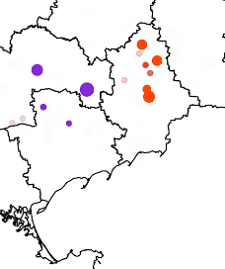
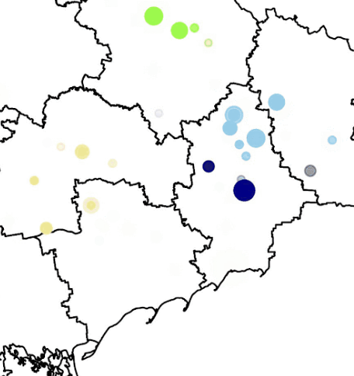
K-Means Clustering vs AgC Average?
AgC Average!
AgC Average
K-Means

Slide 35
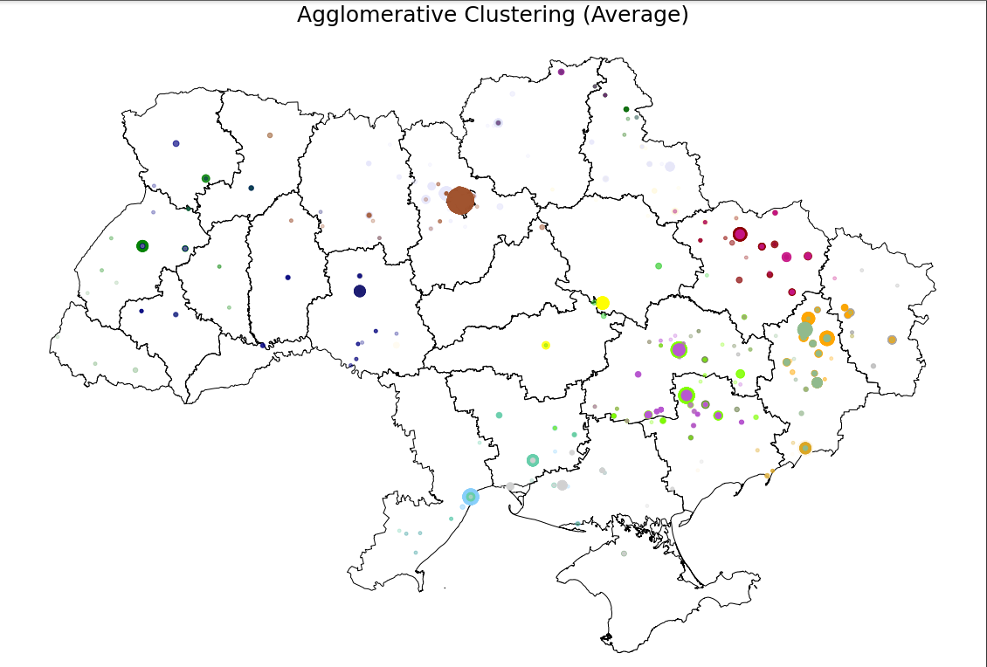

Slide 36
Thank you! Questions?

